Slide 1


Theory of Production
CA-Foundation
Q1. How is production in the economic sense distinguished from non-market activities performed within a household ?
[SEPT-24]
(a) Involvement of love and affection
(b) Exchange in the market.
(c) Voluntary nature of the activity level of satisfaction
(d) Intangible outputs

Slide 2
Theory of Production
CA-Foundation
Q2 Use the following information to answer question No 2
What is the marginal product of the second hour of labour?
? [Sept-24]
Hours | Total product | Average Product | Marginal Product
0 | _____ | ______ | _____
1 | 20 | 20 | _____
2 | 50 | _______ | _______
3 | 90 | ______ | 40
4 | ______ | 30 | ______
(a) 10
(b) 20
(c) 30
(d) 40

Slide 3
Theory of Production
CA-Foundation
Q3. Use the following information to answer questions 3
What is the average product for the third hour of labour ?
[Sept-24]
Hours | Total product | Average Product | Marginal Product
0 | _____ | ______ | _____
1 | 20 | 20 | _____
2 | 50 | _______ | _______
3 | 90 | ______ | 40
4 | ______ | 30 | ______
(a) 25
(b) 30
(c) 35
(d) 40

Slide 4
Theory of Production
CA-Foundation
Q4 When does the Law of Variable Proportions, or the Law of
Diminishing Returns, become relevant?
[Sept-24]
(a) In the long run
(b) In short run
(c) In both short run and long run
(d) only when all factors are variable

Slide 5
Theory of Production
CA-Foundation
Q5 What is the primary characteristic of Decreasing Returns to Scale?
[Sept-24]
(a)$\text{Total} \text{output} \text{increases} \text{at} \text{an} \text{increasing} \text{rate}$
(b) Total output increases at a decreasing rate
(c) Total output remains constant
(d) Total output decreases

Slide 6
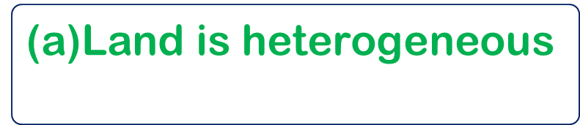
Theory of Production
CA-Foundation
Q6 Which of the following is not a characteristics of land ?
[Jan-25]
(b) Land is an active factor
(a)$\text{Land} \text{is} \text{heterogeneous}$
(c) Supply of land is fixed
(d) Land has multiple uses

Slide 7
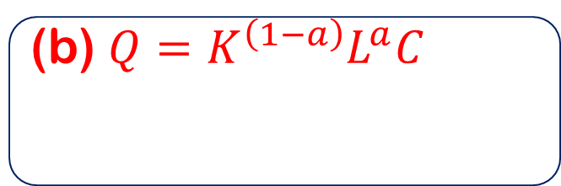
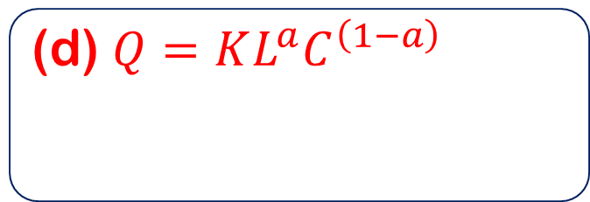
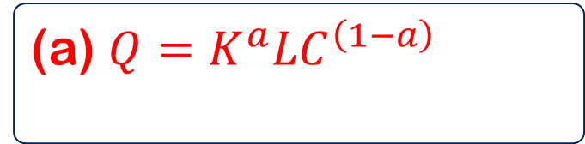
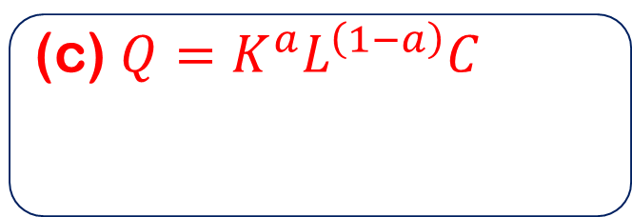
Theory of Production
CA-Foundation
Q7 Cobb- Douglas production function is stated as :
[Jan-25]
(a) $Q=K^{a}L\text{​}C^{\left(1−a\right)}$
(b) $Q=K^{\left(1−a\right)}L^{a}\text{​}C$
(c) $Q=K^{a}L^{\left(1−a\right)}\text{​}C$
(d) $Q=KL^{a}\text{​}C^{\left(1−a\right)}$

Slide 8
Theory of Production
CA-Foundation
Q8 Based on the information given in the following table , answer the Question Nos. 8
What will be the average product when quantity of labour is 6?
[Jan-25]
Quantity of labour | Total Product (TP) | Average product (AP) | Marginal Product(MP)
1 | 10 | ____ | _____
2 | _____ | _____ | 11
3 | _____ | 11 | ____
4 | _____ | ____ | 11
5 | 52 | ______ | _____
6 | ____ | _____ | 8
(a) 9
(b) 10
(c) 11
(d) 12

Slide 9
Theory of Production
CA-Foundation
Q9 Based on the information given in the following table , answer the Question Nos. 9
What will the total product when quantity of labour is 4?
[Jan-25]
Quantity of labour | Total Product (TP) | Average product (AP) | Marginal Product(MP)
1 | 10 | ____ | _____
2 | _____ | _____ | 11
3 | _____ | 11 | ____
4 | _____ | ____ | 11
5 | 52 | ______ | _____
6 | ____ | _____ | 8
(a) 38
(b) 40
(c) 42
(d) 44

Slide 10
Theory of Production
CA-Foundation
Q10 Based on the information given in the following table , answer the Question Nos. 10
What will be the marginal product when quantity of labour is 5??
[Jan-25]
Quantity of labour | Total Product (TP) | Average product (AP) | Marginal Product(MP)
1 | 10 | ____ | _____
2 | _____ | _____ | 11
3 | _____ | 11 | ____
4 | _____ | ____ | 11
5 | 52 | ______ | _____
6 | ____ | _____ | 8
(a) 8
(b) 9
(c) 10
(d) 11

Slide 11
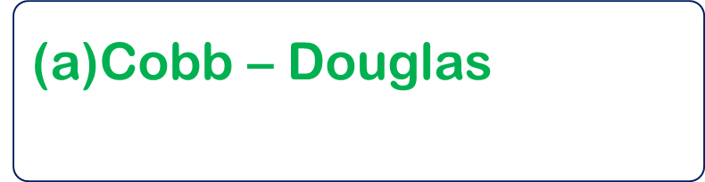
Theory of Production
CA-Foundation
Q11 Who describes production function as the relationship between the maximum amount of output that can be produced and the input required to make that output ?
[Jan-25]
(a)$\text{Cobb}\text{ – }\text{Douglas}$
(b) Samuelson
(c) Paul – Sweezy
(d) Alfred Marshall

Slide 12
Theory of Production
CA-Foundation
Q12 Initially a firm enjoys ________ of scale and beyond a certain limit it suffers from ____ of scale
[Jan-25]
(a) Internal economics , internal diseconomies
(b) External economies , external diseconomies
(c) Internal diseconomies , internal economies
(d) External diseconomies , external economies

Slide 13

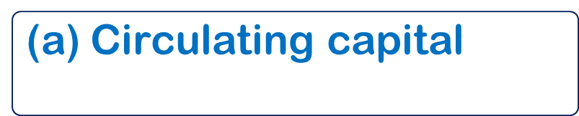
Theory of Production
CA-Foundation
Q13 The form of capital which performs its function in production in a single use and is not available for further used in termed as :
[May -25]
(a)$\text{Circulating} \text{capital}$
(b) Fixed Capital
(c) Real capital
(d) Intangible capital

Slide 14

Theory of Production
CA-Foundation
Q14 Survival , growth and expansion come under which of the following objective of an enterprise ?:
[May -25]
(a)$\text{Economic} \text{objective}$
(b) organic objective
(c) Social objective
(d) National objective

Slide 15
Theory of Production
CA-Foundation
Q15 Returns to scale refers to :
[May-25]
(a) Changes in output as a result of proportionate change in all factors of production .
(b) Changes in output as a result of proportionate change in one of the variable factors of production
(c) Changes in output as a result of proportionate change in any two variable factors of production .
(d) Changes in output as a result of variation in factor proportions .

Slide 16
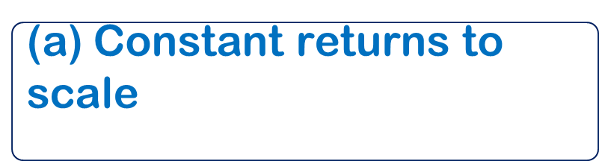
Theory of Production
CA-Foundation
Q16 Linear Homogenous Production function is another name for _________.
[May-25]
(a)$\text{Constant} \text{returns} \text{to} \text{scale}$
(b) Law of variable proportion
(c) increasing returns to scale
(d) Decreasing returns to scale

Slide 17

Theory of Production
CA-Foundation
Q17 The minimum quantities of various inputs that are required to yield a given quantity of output is termed as :
[May-25]
(a)$\text{Supply} \text{function}$
(b) Demand function
(c) Production function
(d) Investment function

Slide 18
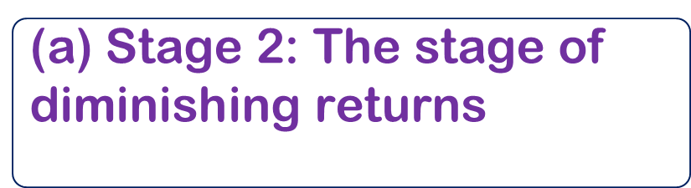
Theory of Production
CA-Foundation
Q18 Total product starts declining in which stage of production ?:
[May-25]
(a) $\text{Stage}\text{ 2: }\text{The} \text{stage} \text{of} \text{diminishing} \text{returns}$
(b) Stage 1: The stage of increasing returns
(c) Stage 3: The stage of negative returns
(d) It may decline in any stage of production

Slide 19
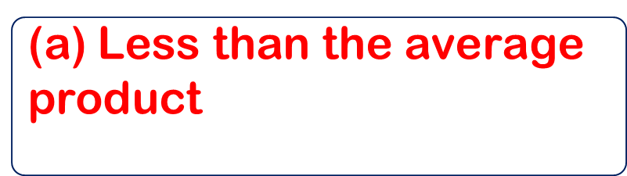
Theory of Production
CA-Foundation
Q19 When average product rises as a result of an increase in the quantity of variable input , marginal product is :
[Sept-25]
(a)$\text{Less} \text{than} \text{the} \text{average} \text{product}$
(b) Minimum
(c) Equal to the average product
(d) More than the average product

Slide 20
Theory of Production
CA-Foundation
Q20 Based on the information given in the following table , answer questions Nos. 20
What will be the total product when the quantity of labour is 5?
[Sept-25]
Quantity of labour | Total Product (TP) | Average Product (AP) | Marginal Product (MP)
0 | 0 | ______ | _____
1 | ______ | ______ | 20
2 | _______ | ______ | 26
3 | 66 | ______ | ______
4 | ______ | 19 | ______
5 | ______ | _____ | 4
(a) 86
(b) 84
(c) 80
(d) 92

Slide 21
Theory of Production
CA-Foundation
Q21 Based on the information given in the following table , answer questions Nos. 21
What will be the marginal product when quantity of labour is 4?
[Sept-25]
Quantity of labour | Total Product (TP) | Average Product (AP) | Marginal Product (MP)
0 | 0 | ______ | _____
1 | ______ | ______ | 20
2 | _______ | ______ | 26
3 | 66 | ______ | ______
4 | ______ | 19 | ______
5 | ______ | _____ | 4
(a) 26
(b) 20
(c) 10
(d) 19

Slide 22
Theory of Production
CA-Foundation
Q22 Based on the information given in the following table , answer questions Nos. 21
What will be the average product when the quantity of labour is 3??
[Sept-25]
Quantity of labour | Total Product (TP) | Average Product (AP) | Marginal Product (MP)
0 | 0 | ______ | _____
1 | ______ | ______ | 20
2 | _______ | ______ | 26
3 | 66 | ______ | ______
4 | ______ | 19 | ______
5 | ______ | _____ | 4
(a) 22
(b) 24
(c) 20
(d) 18

Slide 23
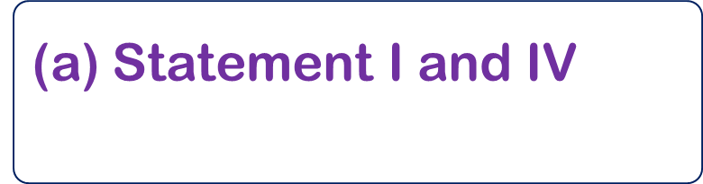
Theory of Production
CA-Foundation
Q23 Which of the following statements are correct ?
Statement I : A period will be considered short – run period if the amount of at least one of the inputs used remains unchanged during that period
Statement II : The long run is a period of time in which all factors of production are variable
Statement III : In the short run all inputs are fixed
Statement IV : In the long run all inputs except one are fixed
[Sept-25]
(a)$\text{Statement} \text{I} \text{and} \text{IV}$
(b) Statement II and III
(c) Statement I and II
(d) Statement III and IV

Slide 24
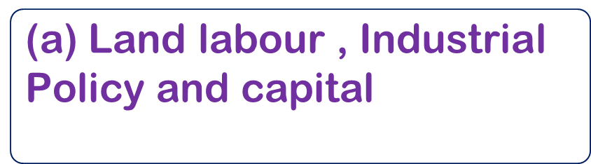
Theory of Production
CA-Foundation
Q24 Which of the following factors or resources makes it possible to produce goods and services ?
[Sept-25]
(a) $\text{Land} \text{labour}\text{ , }\text{Industrial} \text{Policy} \text{and} \text{capital}$
(b) Land , Labour , Fiscial policy and Capital
(c) Land , Labour , Capital and Entreprenship ability
(d) Land , Labour , Technology and capital

Slide 25

Theory of Production
CA-Foundation
Q25 In Cobb -Douglas production function , output is manufactured production and inputs used are
[Sept-25]
(a)$\text{Entrepreneurship} \text{and} \text{land}$
(b) Labour and capital
(c) Land and labour
(d) Entrepreneurship and capital

Slide 26
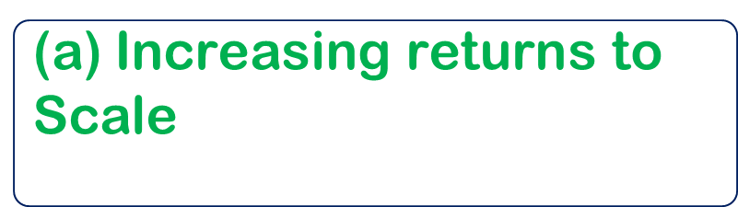
Theory of Production
CA-Foundation
Q26 If a firm adds more number of workers but total output starts to increase at a decreasing rate , the firm is experiencing
[Sept-25]
(a)$\text{Increasing} \text{returns} \text{to} \text{Scale}$
(b) Diminishing Marginal Returns
(c) Constant Returns to Scale
(d) Negative Marginal Returns

Slide 27
Theory of Production
CA-Foundation
Q27 What does the term entrepreneur in economics refer to :
[JAN-26]
(a) The person combining factors of production , bearing risk , and innovating
(b) The person who only owns land or property
(c) The head of the marketing department
(d) The investor in machinery and products

Slide 28

Theory of Production
CA-Foundation
Q28 __________ capital performs its function in production in a single use and is not available for further use . Choose the correct option
[JAN-26]
(a)$\text{Real}$
(b) Circulating
(c) Tangible
(d) Intangible

Slide 29
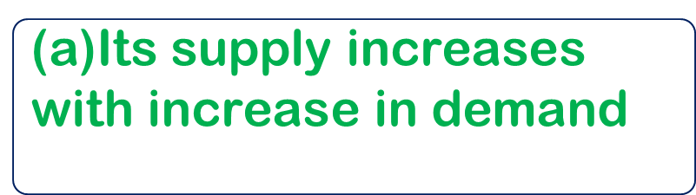
Theory of Production
CA-Foundation
Q29 “ Total Supply of land is perfectly inelastic from the point of view the economy “. , it means
[JAN-26]
(a)$\text{Its} \text{supply} \text{increases} \text{with} \text{increase} \text{in} \text{demand}$
(b) Its supply is unaffected with change in demand
(c) Its supply decreases with increase in demand
(d) Its supply decreases with decrease in demand .

Slide 30
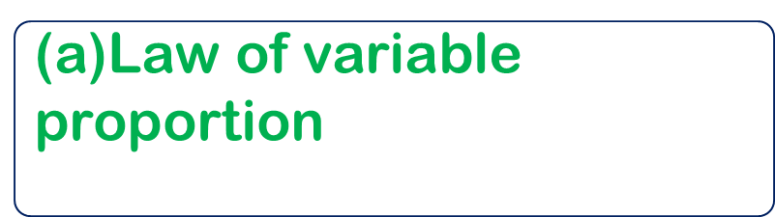
Theory of Production
CA-Foundation
Q30 Relationship between inputs and outputs , when all inputs are changed in the small proportion are called
[JAN-26]
(a)$\text{Law} \text{of} \text{variable} \text{proportion}$
(b) Returns to Scale
(c) Isoquants
(d) Iso – cost lines

Slide 31
Theory of Production
CA-Foundation
Q31 Which of the following is not true with regard to stage of diminishing returns ?
[JAN-26]
(a) Total product continues to decrease
(b) Both marginal product and average product of the variable are diminishing but are positive
(c) A rational producer will seek to produce within the range of this stage
(d) By the end of this stage , total product reaches its maximum

Slide 32
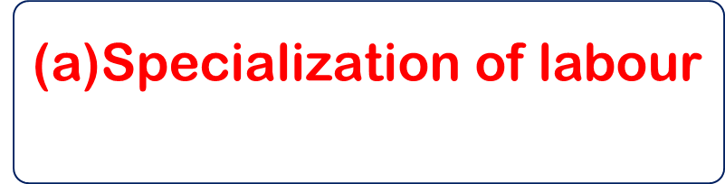
Theory of Production
CA-Foundation
Q32 Which of the following factors does not lead to internal economies of scale :
[JAN-26]
(a)$\text{Specialization} \text{of} \text{labour}$
(b) Use of superior techniques
(c) Use of by – products
(d) Supply of skilled labour

Slide 33
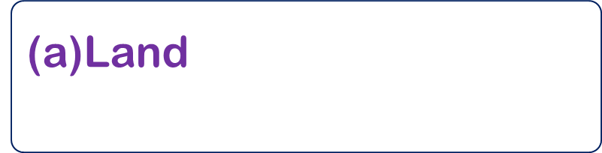
Theory of Production
CA-Foundation
Q33 Which factor of production is that part of the wealth of an individual or community , which may be used for further production of wealth ?
[MAY-26]
(a)$\text{Land}$
(b) Labour
(c) Capital
(d) Entrepreneur

Slide 34

Theory of Production
CA-Foundation
Q34 To make the job contents interesting and challenging is a ________________objective of an organization
[MAY-26]
(a)$\text{Social}$
(b) Organic
(c) National
(d) Human

Slide 35
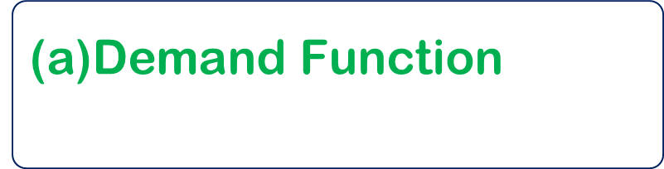
Theory of Production
CA-Foundation
Q35 The maximum amount of output that can be produced with given quantities of inputs , under a given state of technical knowledge , is termed as :
[MAY-26]
(a)$\text{Demand} \text{Function}$
(b) Production Function
(c) Supply Function
(d) Investment Function

Slide 36
Theory of Production
CA-Foundation
Q36 The three stages of the law of variable proportion can be referred to as the stages of ________
[MAY-26]
(a) Increasing returns , optimum returns & nil returns
(b) Positive returns , diminishing returns & nil returns
(c) Increasing returns , diminishing returns &negative returns
(d) Negative returns , nil returns & Positive returns

Slide 37

Theory of Production
CA-Foundation
Answer Key
Ans. 1 (b) | Ans. 2 (c) | Ans. 3 (b) | Ans. 4 (b)
Ans. 5 (b) | Ans. 6 (b) | Ans. 7 (d) | Ans. 8 (b)
Ans. 9 (d) | Ans. 10 (a) | Ans. 11 (b) | Ans. 12 (a)
Ans.13 (a) | Ans. 14 (b) | Ans. 15(a) | Ans. 16 (a)
Ans.17(c) | Ans. 18 (c) | Ans. 19 (d) | Ans. 20 (c)
Ans.21 (c) | Ans. 22 (a) | Ans. 23 (c) | Ans. 24 (c)
Ans. 25(b) | Ans. 26 (b) | Ans. 27 (a) | Ans. 28 (b)
Ans. 29 (b) | Ans. 30(b) | Ans. 31 (a) | Ans. 32 (d)
Ans. 33 (c) | Ans. 34(a) | Ans. 35 (b) | Ans. 36 (c)

