Slide 1


Indifference curve
CA-Foundation
Q1. “With respect to the properties of indifference curve which of the following statement is false ?
[SEPT-24]
(a) Higher indifference curve represents higher level of satisfaction.
(b) Indifference curve is a negatively sloped line.
(c) Intersecting point of two indifference curves represents highest level of satisfaction
(d) An indifference curve is convex to the origin

Slide 2
Indifference curve
CA-Foundation
Q2. Which tool does the ordinal utility approach uses to analyse consumer behavior and is based on the consumer preferences ?
[Sept-24]
(a) Indifference Curve Analysis.
(b) Law of Diminishing Marginal utility.
(c) Elasticity of Demand
(d) Consumer Surplus.

Slide 3
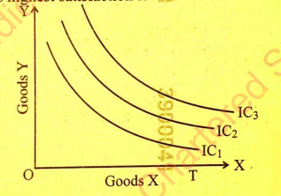
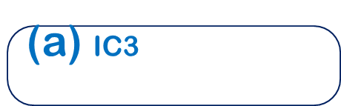
Indifference curve
CA-Foundation
Q3 With reference to the following indifference map , ,which of the following curve represents highest satisfaction level ?
[Jan-25]
(a) $\text{IC}\text{3}$
(b) IC2
(c) IC1
(d) All the curves represent same satisfaction level

Slide 4
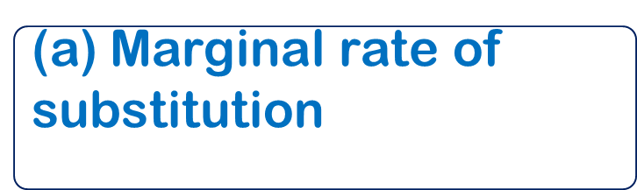
Indifference curve
CA-Foundation
Q4 The rate at which consumer is prepared to exchange goods X and Y , holding the level of satisfaction constant is called as _________. .
[May-25]
(a)$\text{Marginal} \text{rate} \text{of} \text{substitution}$
(b) Indifference curve
(d) Consumer surplus
(c) Diminishing marginal utility

Slide 5
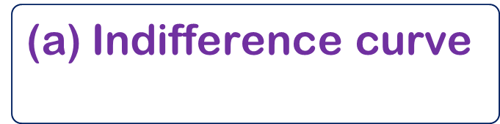
Indifference curve
CA-Foundation
Q5 Budget line or budget constraint line which shows the various alternative combinations of two factors which the firm can buy with given outlay is called :
[May-25]
(a)$\text{Indifference} \text{curve}$
(b) Isoquant
(c) Isocost line
(d) Iso – product curve

Slide 6
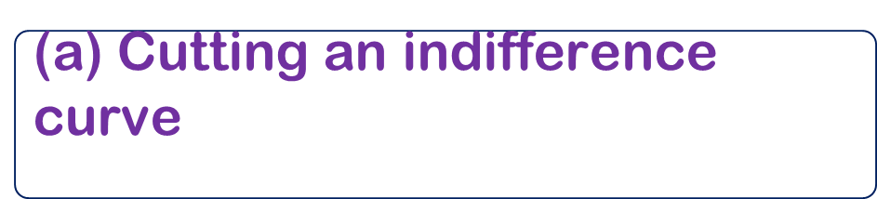
Indifference curve
CA-Foundation
Q6 The consumer is in equilibrium position at a point where the price line is.
[Sept-25]
(a) $\text{Cutting} \text{an} \text{indifference} \text{curve}$
(b) Below the indifference curve
(c) Tangent to an indifference curve
(d) Above an indifference curve

Slide 7
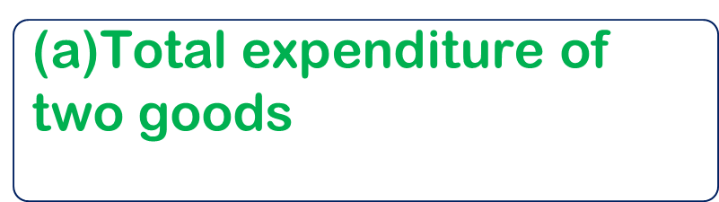
Indifference curve
CA-Foundation
Q7 The slope of the budget line is determined by the relative prices of the goods and is equal to :
[Sept-25]
(a)$\text{Total} \text{expenditure} \text{of} \text{two} \text{goods}$
(b) The price of two goods
(c) The income of the consumer
(d) The marginal utility of goods

Slide 8
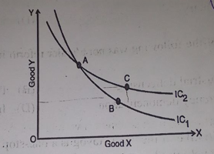
Indifference curve
CA-Foundation
Q8 Consider the indifference curves given below. What can you infer about the relationship between Good X and Good Y ?
[JAN-26]
(a) Good X and Good Y are prefect substitutes of each other
(b) Good X and Good Y are prefect complements
(c) The relationship between Good X and Good Y is logically absurd
(d) Good X and Good Y are same

Slide 9
Indifference curve
CA-Foundation
Q9 A curve which shows all the different combinations of inputs that can produce same level of output is known as :
[JAN-26]
(a) Marginal Cost curve
(b) Isocost
(c) Isoquant
(d) Total product cost

Slide 10

Indifference curve
CA-Foundation
Q10 Choose the correct option from the following that is not true property of an Indifference curve (IC)
[MAY-26]
(a)$\text{IC} \text{slopes} \text{upwards} \text{to} \text{the} \text{right}$
(b) IC is always convex to the origin
(c) IC will touch either axis
(d) IC can never intersect each other

Slide 11

Indifference curve
CA-Foundation
Answer Key
Ans. 1 (c) | Ans. 2 (a) | Ans. 3 (a) | Ans. 4 (a)
Ans. 5 (c) | Ans. 6 (c) | Ans. 7 (b) | Ans. 8 (c)
Ans. 9 (c) | Ans. 10 (a)

