Slide 1

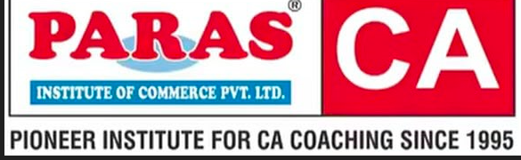
Oligopoly
CA-Foundation
Q1 Three major smartphone manufacturers, Alpha Tech, Beta Mobile, and Gamma Gadgets, dominate the smartphone market. These companies are in constant competition for market share and innovation. Which type of the market structure has been described in this scenario? [SEPT-24]
(a) Monopoly
(b) Oligopoly
(c) Perfect competition
(d) Monopolistic Competition

Slide 2
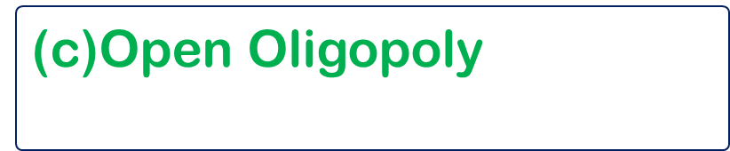
Oligopoly
CA-Foundation
Q2 Talcum powder market is an example of which of the following market
[Sept-24]
(a) Collusive Oligopoly
(b) Imperfect Oligopoly
(c)Open Oligopoly$1$
(d) Close Oligopoly

Slide 3
Oligopoly
CA-Foundation
Q3. According to the Kinked demand curve hypothesis , why does the demand curve facing an oligopolist have a ‘ Kink ‘ at prevailing price level ? :
[Sept-24]
(a) To create confusion among competitors
(b) To make the demand curve visually interesting
(c) The segment above price is highly elastic, and below it is inelastic
(d) It is a graphical error in the representation

Slide 4
Oligopoly
CA-Foundation
Q4 A market structure in which there is only a single buyer and a single seller is known as :
? [Sept-24]
(a) Monopsony
(b) Bilateral Monopoly
(c) Oligopoly
(d) Duopoly

Slide 5
Oligopoly
CA-Foundation
Q5 In oligopoly , when industry is dominated by one large firm which is considered as leader of the group , then it is called : of :
[Jan-25]
(a) Open oligopoly
(b) collusive oligopoly
(c) partial oligopoly
(d) syndicated oligopoly.

Slide 6
Oligopoly
CA-Foundation
Q6 Kinked demand curve model of oligopoly is also called :.
[May-25]
(a) Mckisney’s Model
(b) Sweezy’s Model
(c) Oskar’s model .
(d) Neumann’s Model

Slide 7
Oligopoly
CA-Foundation
Q7 The oligopoly market in which few firms come to a common understanding with each other in fixing price or output or both is called
[May -25]
(a) Collusive oligopoly
(b) Pure oligopoly
(c) Partial Oligopoly
(d) Syndicated oligopoly

Slide 8
Oligopoly
CA-Foundation
Q8 Kinked Demand curve is found under :
[Sept -25]
(a) Monopoly
(b) Monopsony
(c) Duopoly
(d) Oligopoly

Slide 9
Oligopoly
CA-Foundation
Q9 Aluminum industry is an example of :.
[Sept -25]
(a) Competitive oligopoly
(b) Perfect oligopoly
(d) open oligopoly
(c) Collusive oligopoly

Slide 10
Oligopoly
CA-Foundation
Q10 A market charterized by a small number of large buyers and is mostly relevant to factor market is termed as :
[JAN-26]
(a) Duopoly
(b) Monopsony
(d) Bilateral monopoly
(c) Oligopsony

Slide 11
Oligopoly
CA-Foundation
Q11 In the Kinked demand curve scenario for oligopoly , what happens when a firm raises its price above the prevailing level ?
[JAN-26]
(a) Competitors follow and raise prices
(b) The demand becomes perfectly inelastic
(c) The firm market share as competitors do not follow
(d) The demand curve is horizontal

Slide 12
Oligopoly
CA-Foundation
Q12 Which of the following is a core charterstic of an oligopoly ?
[JAN-26]
(a) Efficient allocation of resources
(b) Lease advertising
(d) Interdependence between firms
(c) Unique product

Slide 13
Oligopoly
CA-Foundation
Q13 Stagflation is :
[JAN-26]
(a) Increased taxes leading to reduced disposable income
(b) Economic situation where inflation and unemployment exist side by side
(c) Easy transmission of economic instability from one country to other countries
(d) Improved economic stability .

Slide 14
Oligopoly
CA-Foundation
Q14 A group of firms which explicitly collude to coordinate their activities in industries where there are few firms, all of which are similar in size, may be referred to as _______
[MAY-26]
(a) Perfect competition
(b) Cartel
(d) Bilateral monopoly
(c) Oligopoly

Slide 15
Oligopoly
CA-Foundation
Q15 Choose the correct statement about Duopoly from the following statements.
[MAY-26]
(a) It is a special case for the oligopoly market structure.
(b) It is a special case for the Monopsony market structure.
(c) It is a special case for the Monopoly market structure
(d) It is a special case for the Imperfect Competition

Slide 16
Oligopoly
CA-Foundation
Q16 When the goods are sold, based on product differentiation, it is known as _______
[MAY-26]
(a) Collusive oligopoly
(b) Imperfect oligopoly
(d) Syndicated oligopoly
(c) Partial oligopoly

Slide 17
Oligopoly
CA-Foundation
Q17 The “Theory of Games” which provided a different approach to the analysis of strategic behavior of the oligopolists under uncertainty was developed by _________.
[MAY-26]
(a) Alfred Marshal
(b) Adam Smith
(d) Paul A Sweezy
(c) Von Neumann & Oskar Morgenstern

Slide 18
Oligopoly
CA-Foundation
Q18 Which of the following is not a charterstics of the oligopoly market?
[MAY-26]
(a) Strategic Interdependence
(b) Group behavior
(d) Importance to selling costs
(c) No importance to advertising

Slide 19

Oligopoly
CA-Foundation
Answer Key
Ans. 1 (b) | Ans. 2 (b) | Ans. 3 (c) | Ans. 4 (b)
Ans. 5 (c) | Ans. 6 (b) | Ans. 7 (a) | Ans.8(d)
Ans.9 (b) | Ans.10(c) | Ans.11(c) | Ans.12(d)
Ans.13(b) | Ans.14(c) | Ans.15(a) | Ans.16(d)
Ans.17(c) | Ans.18(d)

